Slide 1
What goes around comes around
Mehvish Saleem

Slide 2


Authors
Joseph Hellerstein
Michael Stonebraker

Slide 3
Content
Introduction
Hierarchical IMS Era
Network CODASYL Era
Relational Era
Comparison
Conclusion

Slide 4
introduction

Slide 5
background
Provides a summary of 35 years of data model proposals
Discusses data models divided into 9 eras
Talks about the pros, cons and lessons learned from each era
Example used:
Supplier (sno, sname, scity, sstate)
Part (pno, pname, psize, pcolor)
Supply (sno, pno , qty, price )

Slide 6
Ims (Information management system)

Slide 7
Ims era
Late 1960’s and 1970’s
Hierarchical data model: a collection of instances of record types
Uses a “record-at-a-time” language called DL/I for data manipulation
Stored sequentially or through hashing

Slide 8
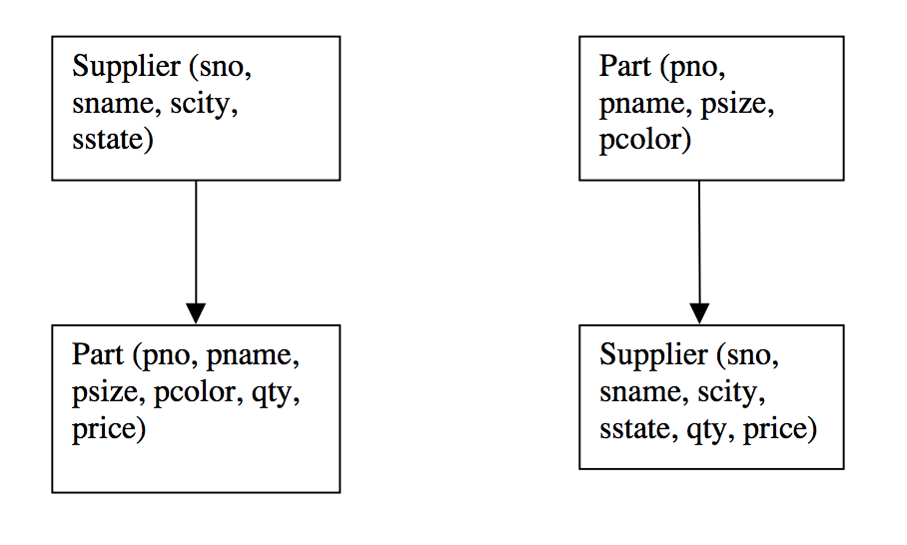
Two Hierarchical organizations

Slide 9
Pros and cons
Simple
Some support for logical data independence
Data Redundancy
Child cannot exist without parent
Lack of physical data independence

Slide 10
Codasyl (Committee on data systems languages)

Slide 11
CODASYL Era
Reports released in 1970s
A directed graph model
Database consists of a collection of record and set instances of the set type
Record-at-a-time data manipulation language

Slide 12
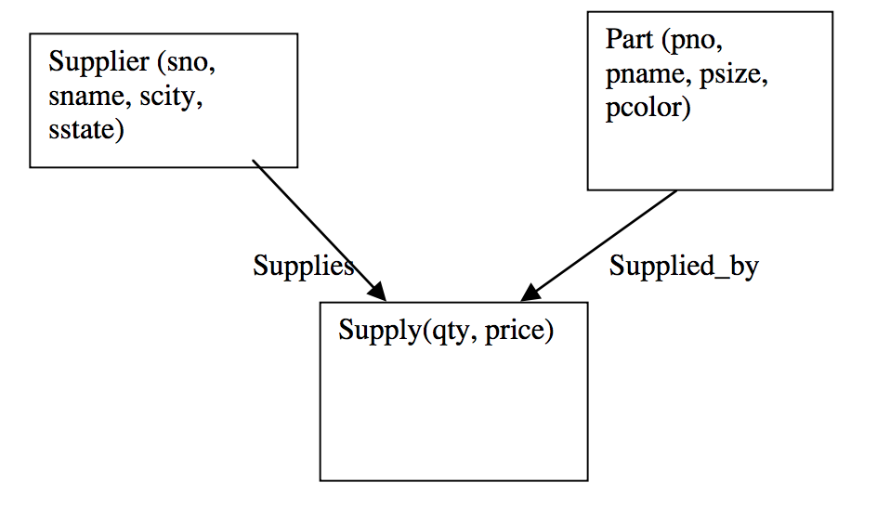
A codasyl directed graph

Slide 13
Pros and cons
Flexible
No redundancy
Can deal with corner cases
Complex model
Long long load times due to the graph structure
Poorer physical and logical independence

Slide 14
Relational

Slide 15
How does it work?
Proposed in 1970 by Ted Codd
Data structured as relations – sets of tuples
Uses a set-at-a-time query language

Slide 16
Relational database
sno | sname | scity | sstate
16 | GS | Boston | MA
24 | SS | Detroit | Mi
sno | pno | qty | price
16 | 27 | 100 | $20.00
24 | 42 | 1000 | $0.08
pno | pname | psize | pcolor
27 | Saw | 7 | silver
42 | bolts | 12 | gray

Slide 17
The great debate
A debate between Tedd Codd and Charlie Bachman (inventor of the network model) lasted through most on 1970s
SIGFIDET ‘74
Conclusion left on the commercial marketplace

Slide 18
Comparison
Arguments against CODASYL:
Too complex
No acceptable data independence
Not flexible enough
Arguments against Relational:
Difficult to understand the new languages
Might not be possible to implement the model efficiently

Slide 19
So who won?
VAX (32-bit minicomputers) supported relational and mainframes supported non-relational
IBM announced dual support for IMS and DB/2 (an early relational database)
SQL established as the standard relational database language

Slide 20
What did we learn?
The importance of data independence
Tree structured models are restrictive
Optimization of record-at-a-time queries is hard
Directed graphs are more flexible than hierarchies but more complex
Set-a-time languages offer more data independence
Technical debates are usually settled by market giants

Slide 21
Thank you!

